Slide 1
S.PRAYEK
India Meteorological Department
Station: DWR Machilipatnam
Designation :Scientist –D
Email –ID: prayek.sandepogu@imd.gov.in
Mobile No: 8099288498

Slide 2
How do pulsed radars calculate range
Pulse width (h)
Distance =Velocity *Time
Distance =2*Range
Range (R) = C . t / 2
Rmax = C. T / 2
T = 1/ PRF
Rmax = C/ 2 PRF
Receiving period
Time period (T)
PRF – Number of pulses transmitted per second

Slide 3
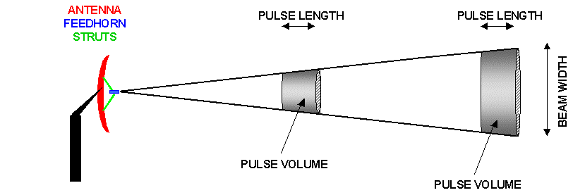
DETERMINING THE PULSE LENGTH
An example:
For a Pulse duration of 1 μs and 2 μs and considering the Speed of light: 300 meters per microsecond
In a pulsed radar ,If a pulse width of 1 µ sec is used 150 meters is the distance from radar where we starts to receive/process the echo (because receive is off when transmitter is on in plused radars )
Pulse Length = Pulse duration μs X 300 m μs-1
The pulse length are: 300 m and 600 m respectively
Half of Pulse length will be equivalent to the "length" of each “bin” for which the data is collected. It determines the range resolution.
Pulse creates a BIN volume: length times width and height
Better resolution with shorter duration and shorter range

Slide 4
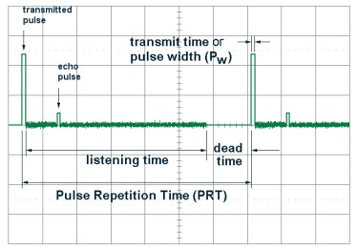
DETERMINING THE MAXIMUM RADAR RANGE
An example:
With a PRF of 500 pulses per second (pps), which correspond to a pulse every 2000 μs
Pulse travels 2000μs x 300m μs⁻¹ = 600,000 m or 600 km
Maximum Range is 300 km, given equal time for a return echo to come back to the radar
IMD DWR PRF´s:
250 Hz to 800 Hz at 2 μs (Max.range of 600 to 188 km )
250 Hz to 1200 Hz at 1 μs( Max range of 600 to 125 km )
Conclusion:
higher PRF, shorter range;
lower PRF = longer range

Slide 5
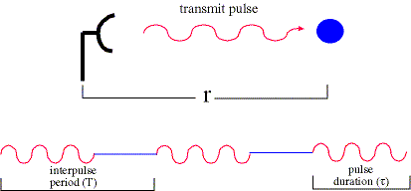
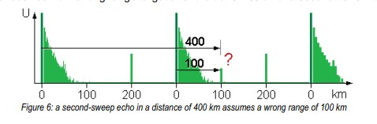
Range Folding
Q: What is the maximum unambiguous range at which a radar can see a target?
so, if target is at range less than or equal to Ru, target will be displayed at correct range
if target is beyond Ru, it will not.
example: if target is at r=170 km and Ru=150 km, the radar thinks it is at 20 km and that is where the echo will be displayed.
This is called range folding.
Range folded echoes are called second trip echoes

Slide 6
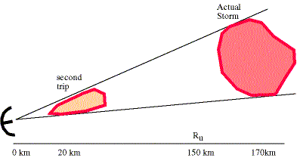
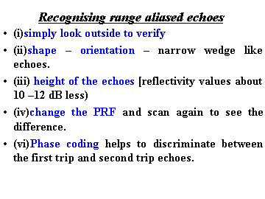
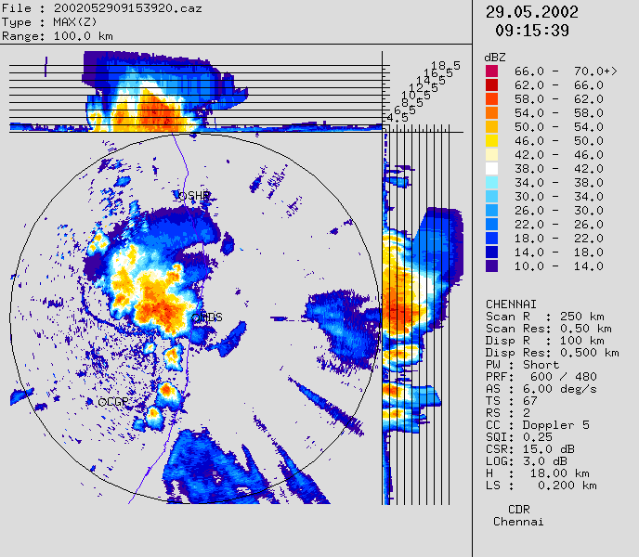
Second-Trip Echo
First pulse from strong storm beyond R_{max} arrives same time the receiver expects a second pulse from within R_{max}, at same relative distance. Echoes show up as elongated streaks along radials.

Slide 7
Unfolding the folded range of the radar
Example:
Target distance from radar when using 300 prf =110KM
Target distance from radar when using 500 prf =10KM
Cal the actual distance of target=X1
RU1=500KM
RU2=300KM
110+n1*500=X1------> (1)
10+n2*300 =X1 ----- > (2)
Equating and solving 1 and 2
100=n2*300-n1*500-----> (3)
Put n1=1 and n2=2
From eq (1)
X1=610KM

Slide 8
Doppler
Frequency shift associated with motion
Examples
Sound of a train approaching and receding
Red shift associated with an expanding universe
Measuring blood flow in the veins
Police radars catching speeders

Slide 9
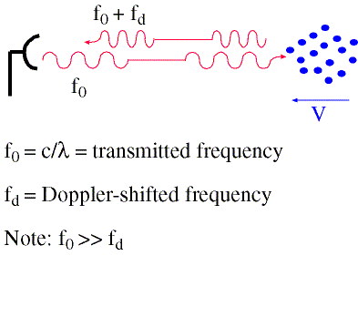
Doppler Velocity - The Doppler shift
How does the radar get velocity information on the particles? Measures a Doppler shift - change in frequency of radiation due to motion of scatterers

Slide 10
Doppler Radar
Ability to measure both power and phase
Weather radars do not measure the frequency shift within a pulse
Weather radars measure the phase shift between pulses

Slide 11
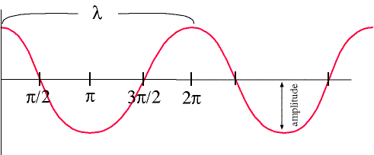
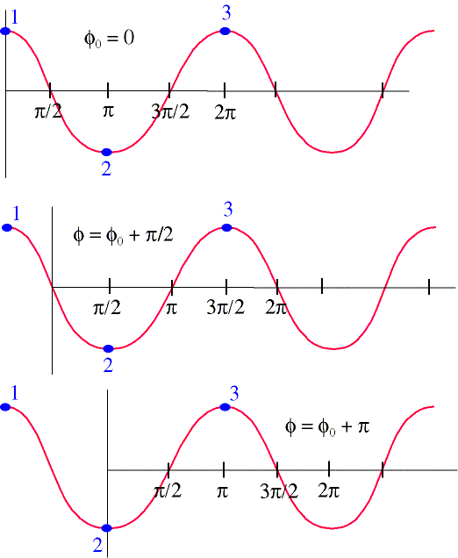
Review of Waves
Anatomy of a cosine wave -->> Amplitude wavelength expressed in physical distance (e.g., cm) also recall that λ=2∏ rad Phase Phase of a Wave Phase is the offset of the wave from a reference point φ₀ example -->>

Slide 12
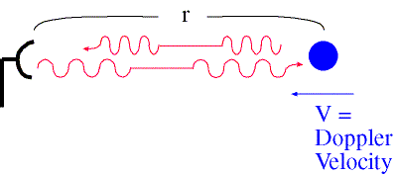
Total Distance to Target in Radians
The total distance (D) traveled by the wave is 2r The number of wave-cycles in the total distance (D) is equal to 2r/λ Thus the distance in terms of radians: Dr = (2r / λ ) 2∏ radians, since one wave-cycle = 2∏ radians. if: φ₀= phase of pulse sent out by radar Φ = phase of returning signal then, φ = φ₀ + 4∏r/λ ……. (1) differentiating (1) yields: dφ /dt =(4∏/λ) (dr/dt) ……. (2)

Slide 13
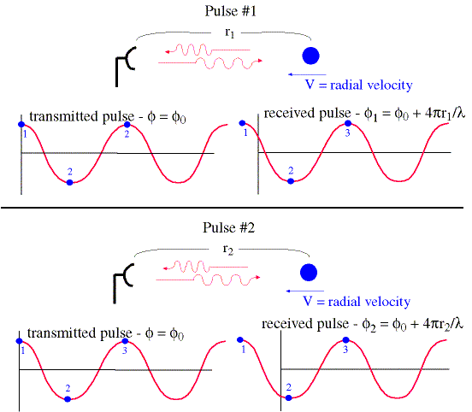
Pulse-Pair Method
Take two consecutive pulses and measure the phase of the received pulses as shown in the schematic -->> Recall that: dφ /dt = (4∏/λ ) (dr/dt) …..(1) where dφ=φ₂-φ₁ dt = time between pulses 1/dt = PRF dr/dt = radial velocity of target=V so: V = (λ /4∏) (φ₂-φ₁) (PRF) ….(2) Maximum unambiguously measurable phase difference is 2∏ radians. | If PRF =1000 s⁻¹ and λ=10 cm, then V_{max} =± 25 ms⁻¹

Slide 14

Pulse-Pair Method continue
Thus maximum unambiguously measurable velocity works out to be
V_{max} =(λ /4∏)(2∏)(PRF) =( λ /2)(PRF)
In practice half of the V_{max} is used for accounting approaching velocity and the other half for accounting receding velocity
Thus Vmax =± (λ /4) (PRF)
+ sign indicates the away from the radar radial wind direction
- Sign indicates towards the radar radial wind direction
Doppler shift :dφ /dt = (4∏/λ ) V since ω=(4∏/λ ) V
2∏ $f_{d}=$4∏/λ * V $f_{d}$=2V/λ

Slide 15

Staggering PRF
Velocity without unfolding method
$Fdmax=\frac{PRF}{2}=\frac{2 Vmax}{λ}$
$Vmax=\frac{PRF∗λ}{4}$
$λ$= 0.053333
For PRF = 1200 fdmax = 600 Hz vmax = 300* =16 m/s
800Hz which corresponds to 21,33m/s in real, but Radar sees this echo as
200Hz which corresponds to 5,33m/s for PRF: 1200Hz (vmax =16m/s) and
350Hz which corresponds to 9,33m/s for PRF: 900Hz (vmax =12m/s)
If 3:4 PRF Ratio applied, folding intersection of F_{d max} for these two PRF will be 1800Hz
new F_{d max} =1800Hz.

Slide 16
Magnitude of the Doppler Shift
Transmitted Frequency
Radial velocity
X band C band S band
9.37 GHz 5.62 GHz 3.0 GHz
1 m/s
10 m/s
50 m/s
62.5 Hz 37.5 Hz 20.0 Hz
625 Hz 375 Hz 200 Hz
3125 Hz 1876 Hz 1000 Hz
These frequency shifts are very small: for this reason, Doppler radars must employ very stable transmitters and receivers
In practice, the pulse volume contains billions of targets moving at different radial speeds and an average phase shift is determined from a train of pulses. V is measured in m/s.

Slide 17
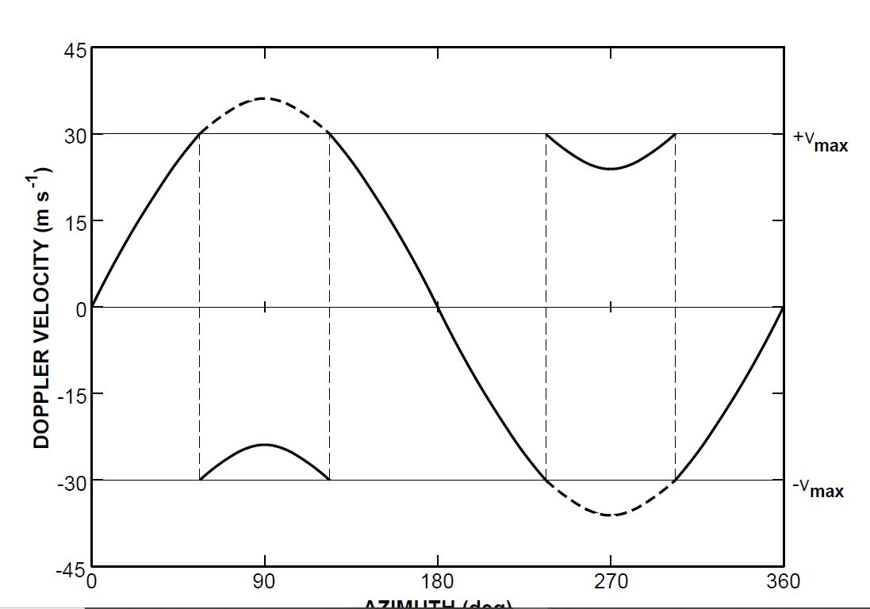
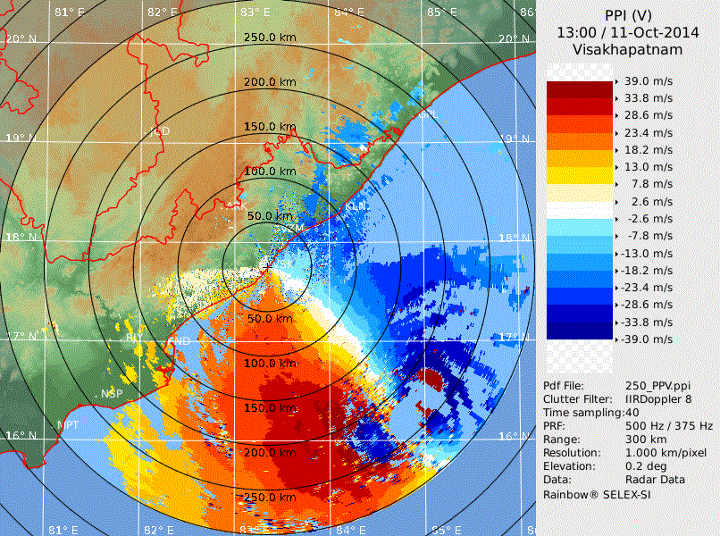
Velocity folding
Velocity folding can be recognized in radar images as sudden change in sign of the radial velocity

Slide 18
Nyquist Velocity versus Unambiguous Range
We can now find a relationship between the nyquist velocity (V_{max}) and the unambiguous range (R_{max}). Recall that: V_{max} =± (λ /4) (PRF) ……….(1) Also recall from way back: R_{max} = C /(2PRF) ……….. (2) (1) X (2) gives: V_{max} R_{max} = ± C λ /8 .……….(3) C λ/8 a constant for a radar and is the Doppler Dilemma So, to increase the nyquist interval, one must decrease the unambiguous range and vice versa.

Slide 19
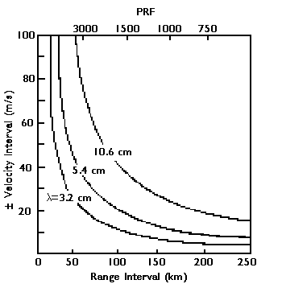
VELOCITY – RANGE FACTOR (Doppler dilemma) for different radar bands and PRFs

Slide 20
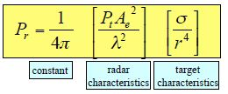
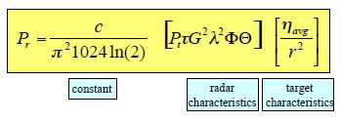

Radar equation
Single target
Distributed targets
Reason: As contributing volume grows with distance, more targets are added. Number of targets added is proportional to r2, which reduces the dependence of the returned power from r-4 to r-2.

Slide 21
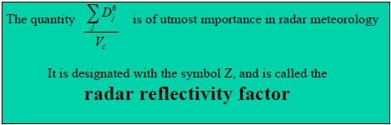
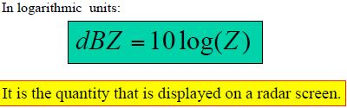
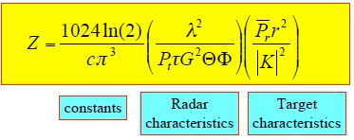
Radar equation

Slide 22
Calibration
Accuracy
Consistency
Quality Control
Comparison and integration

Slide 23
Calibration
Weather radar Calibration
Transmitter
Tx calibration
Transmitted Power, Frequency, PW & OBW
VSWR
Receiver
Noise Figure
Front End Gain
IRR
MDS
Dynamic Range
Freq & Power at Test Points -1.f. Tx Channel -1.g. STALO -1.h. 2nd LO
Antenna
Sun Calibration

Slide 24
RAW DATA OF DOPPLER RADAR
REFLECTIVITY (Z)
INTENSITY OF ECHOES IN THE RANGE –31.5 TO 91 dBZ
Correlates strength of cloud/rain.
VELOCITY (V)
Cosine component of actual wind (Radial velocity). Average of various velocities of different scatterers within a sample volume. One value for each sample volume.
RADIAL VELOCITY OF ECHOES IN THE RANGE +/- 120 MPS MAX AT 1200 PRF AND 4/5 STAGGER RATIO (S-Band radar)
Correlates Radial Velocity of sample volume.
SPECTRAL WIDTH (W)
It is a measure of dispersion of velocities within the pulse volume and is the standard deviation of velocity spectrum.
Depends on turbulence within the pulse volume
Unit of measurement = | m/s |
Useful for measuring Turbulance.

Slide 25
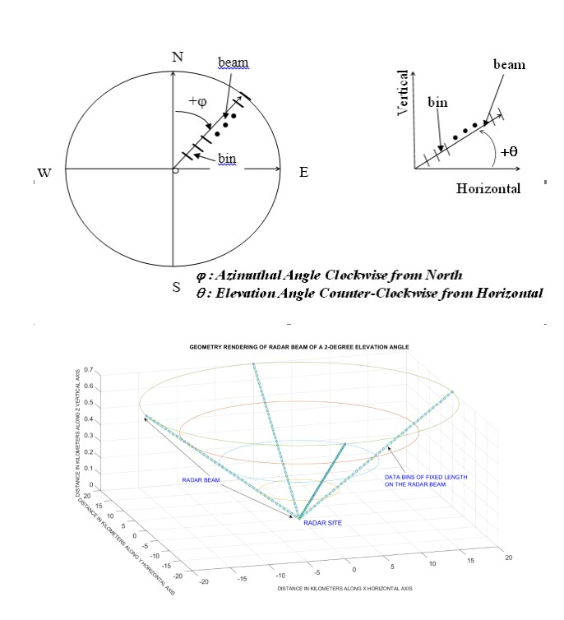
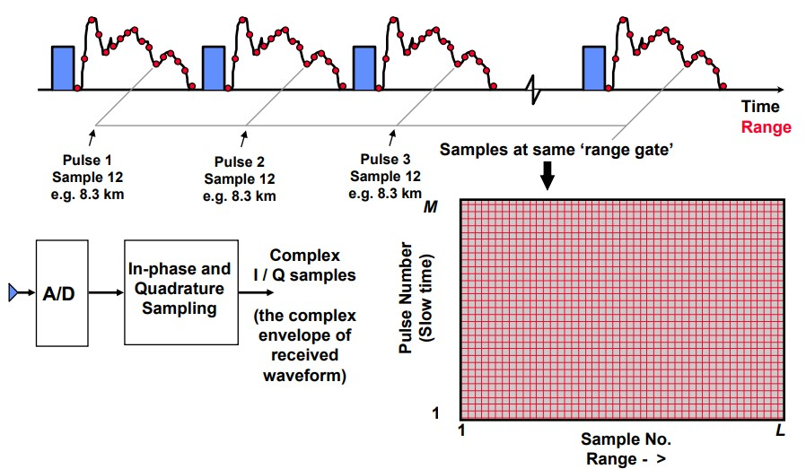
Radar Volume Scan

Slide 26



